Slide 1
Manual Multiply
a data circuit

Slide 2
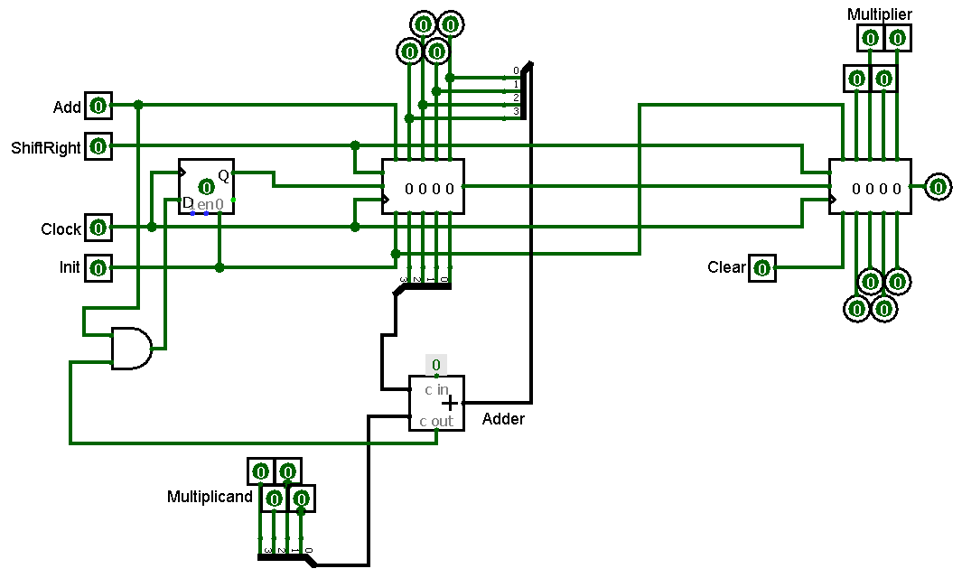
Begin building this circuit
build it in modules with the IP you have been working with use RTL
demonstrate to instructor manually with 4 switches for add/shiftRight/Clock/Init
4 switches for multiplier 4 switches for multiplicand

Slide 3

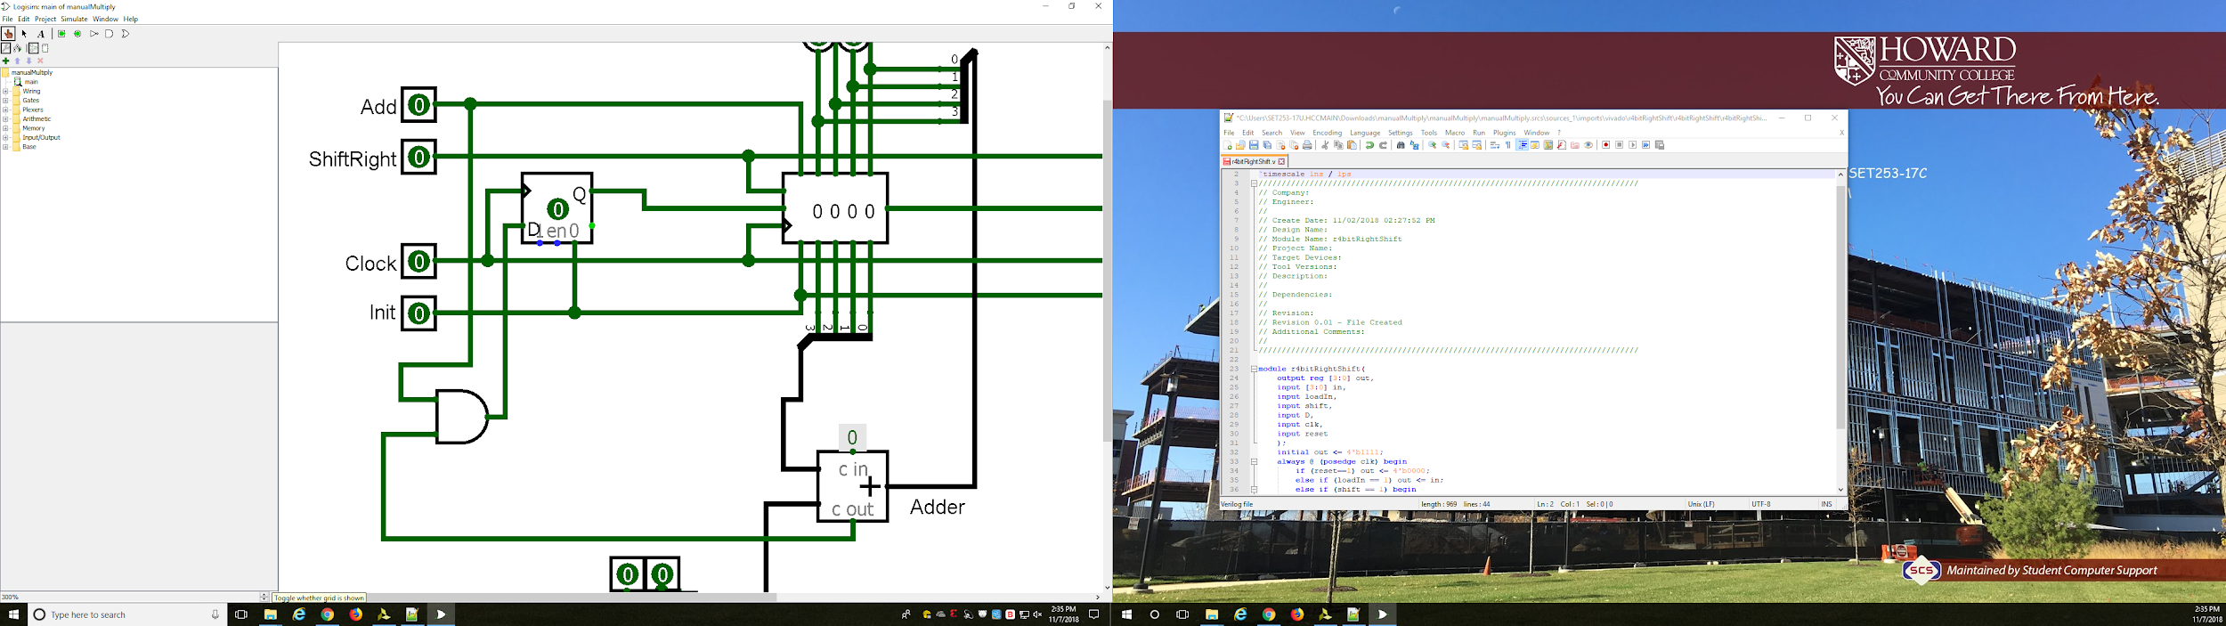
Use this RTL port interface for the top level data circuit
Manual Multiply Vivado Project
LED 7:4 mostsBits
LED 3:0 leastsBits
SW 13 clk
D-FlipFlop
out
out
clk
clk
clk
Q
D
D
D
D
Q
r4bitRightShift
mostBits[0]
r4bitRightShift
addNot
LED 15 addNot
reset
shiftRight reset loadIn in
shiftRight reset loadIn in
SW 14 shiftRight
SW 12 init
clear
SW 15 add
sum
multiplicand
mostsBits
carryOut
sum
multiplier
multiplicand
Add
carryIn
SW 7:4 firstNumberToMultiply
LED 8 carryOut
SW 3:0 secondNumberToMultiply

Slide 4
Biggest Challenge of this Project: clock error
Vivado doesn’t want you creating latches.
Vivado wants you to use RTL … so that it can create them. But this is impossible with a manual clock. So in the error message look for this suggestion:
set_property CLOCK_DEDICATED_ROUTE FALSE [get_nets clk_IBUF]
This challenge was experienced in the manually operated D flip flop project.
name of variable associated with ………. always @(posedge clk)

Slide 5
Add
Has parameters .. see verilog 2012 standard (go to page 88)

Slide 6
Your tasks
Replace the r4RightShift.v module with RTL verilog >> command Replace the adder.v module with a line of RTL code Add reset … separate from the reset of the r4RightShift module Switch to 8 bits use the diamond buttons to manually step through it Keep the dual use of the multiplier register .. don’t copy the Mano add (page393)

